Slide 1
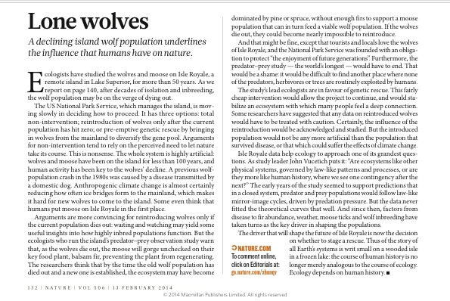
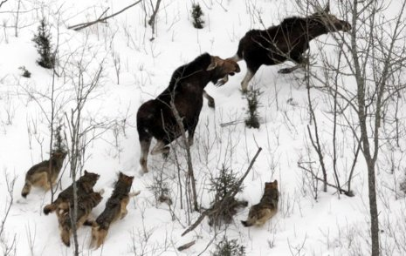
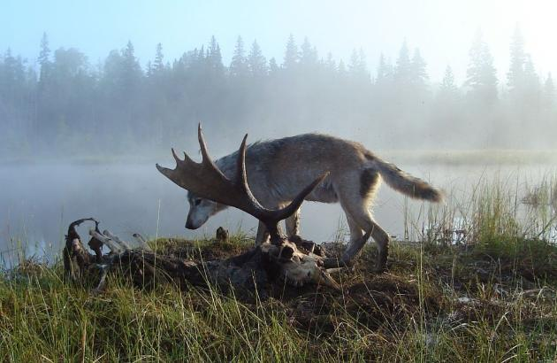
Notes:
Next year assign Petchey 2008 PNAS as reading for discussion?

Slide 2
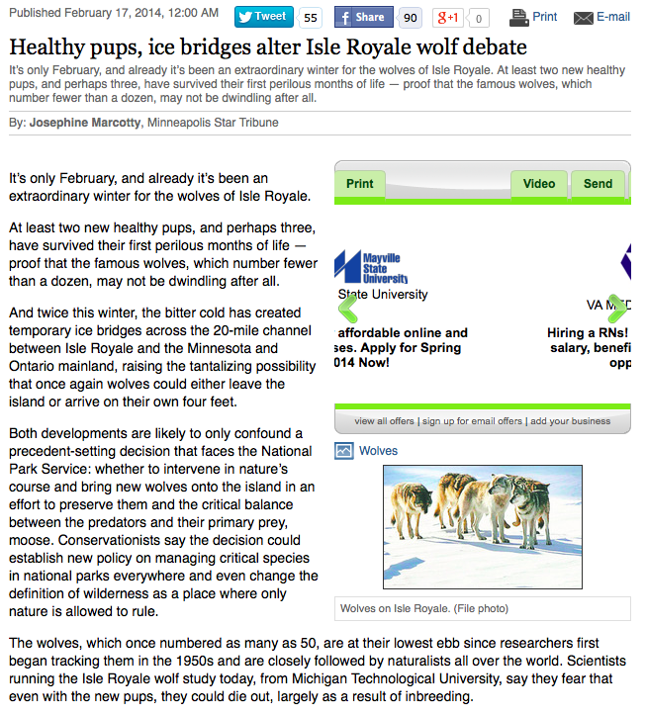
http://www.duluthnewstribune.com/event/article/id/291672/

