Slide 1
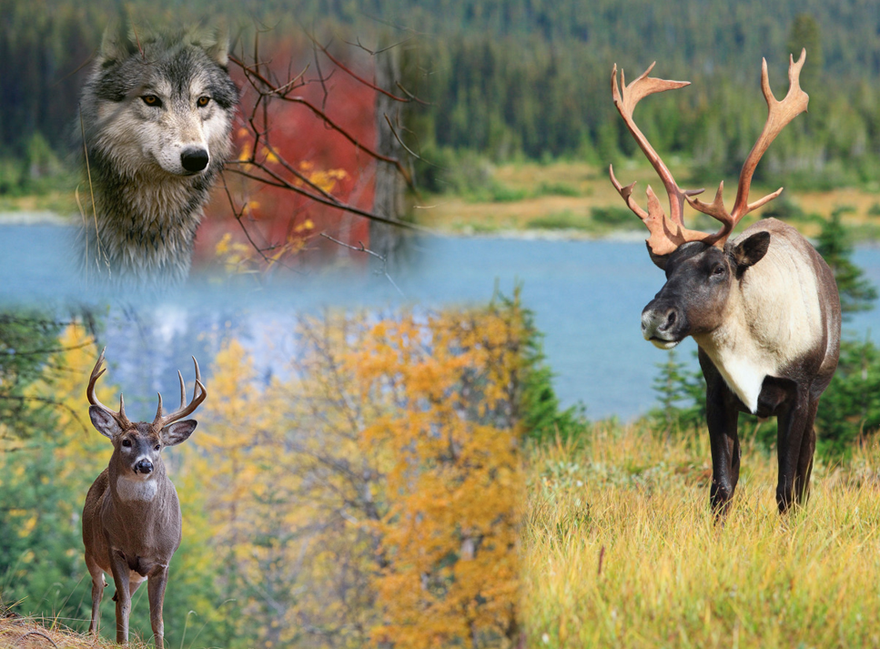
Apparent Competition
Blake Danis and Hannah Britton-Foster
Feb. 20th 2015
http://borealforestfacts.com/wp-content/uploads/2013/09/o-WOODLAND-CARIBOU-BOREAL-FOREST-AGREEMENT-CANADA-facebook.jpg
http://images4.fanpop.com/image/photos/16900000/Wolf-dianas-wolf-pack-16958727-1024-768.jpg
http://www.donaldmjones.com/data/photos/2053_1whitetail_deer39036d.jpg

Slide 2
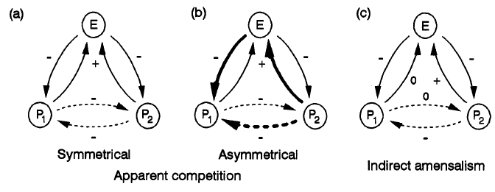
What is Apparent Competition?
Apparent competition:
Indirect ecological interaction between at least two prey species and a shared predator
(Holt 1977)
http://people.biology.ufl.edu/rdholt/images/Bob-in-the-Himalayas.jpg
Notes:
What is apparent competition? It’s a term first coined by Bob Holt in 1977 referring to indirect ecological interaction between two prey species and a shared predator. In symmetrical apparent competition, when one prey species goes up the other goes down and vice versa (a). But you can also have asymmetrical apparent competition where one prey species is much more affected by the predator than the other. Indirect amensalism is an extreme case of asymmetry where one prey species’s success has a negative impact on its apparent competitor but receives no cost or harm from the impacted apparent competitor

Slide 3
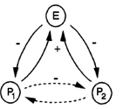
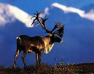
What is Apparent Competition?
Apparent competition:
Indirect ecological interaction between at least two prey species and a shared predator
(Holt 1977)
http://www.sierraclub.ca/sites/sierraclub.ca/files/images/caribou1_0.jpg
http://funmozar.com/white-tailed-deer/
http://dreamatico.com/wolf.html
Notes:
A well-known example of apparent competition occurs between expanding white-tailed deer populations and threatened woodland caribou, with wolves as a shared predator.

Slide 4
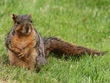
What is Apparent Competition?
Apparent competition:
Indirect ecological interaction between at least two prey species and a shared predator
(Holt 1977)
Not Limited to Predator-Prey Relationships
Brown and Morgan 1995
http://www.nps.gov/prsf/naturescience/images/fox-squirrel.jpg
http://www.babymed.com/sites/default/files/shutterstock_peanuts.jpg
http://upload.wikimedia.org/wikipedia/commons/3/39/Sunflower_Seeds_Kaldari.jpg
Notes:
But apparent competition is not limited to predator-prey relationships. Other studies of apparent competition have included peanut seeds and sunflower seeds with fox squirrel as a shared granivore

Slide 5
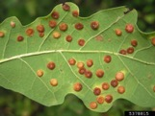
What is Apparent Competition?
Apparent competition:
Indirect ecological interaction between at least two prey species and a shared predator
(Holt 1977)
Not Limited to Predator-Prey Relationships
Brown and Morgan 1995
Hails and Crawley 1991
http://www.bonsai4me.com/Images/SGimages/Quercus%20robur.jpg
https://bugtracks.files.wordpress.com/2011/05/img_0582.jpg
http://butterwicktrees.co.uk/wp-content/uploads/2013/09/treeoak21.jpg
http://bugwoodcloud.org/images/768x512/5378815.jpg
Notes:
Turkey oak and English oak are apparent competitors each with a host-parasite relationship to cynipid wasps

Slide 6
Notes:
But the assigned reading focused on asymmetrical apparent competition among…

Slide 7
Notes:
…predator-prey systems involving one endangered prey species. So let’s take a closer look at asymmetrical apparent competition

Slide 8
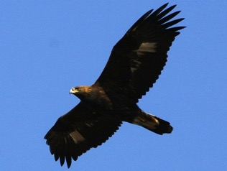
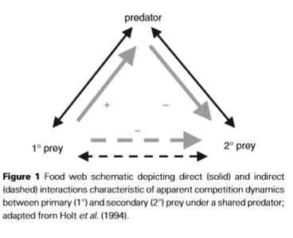
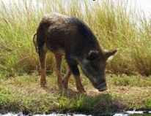
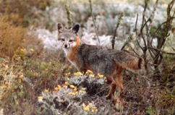
Apparent Competition
DeCesare, N. J., Hebblewhite, M., Robinson, H. S., & Musiani, M. (2010). Endangered, apparently: the role of apparent competition in endangered species conservation. Animal conservation, 13(4), 353-362.
http://upload.wikimedia.org/wikipedia/commons/f/f4/Urocyon_littoralis_full_figure.jpg
http://www.dpi.nsw.gov.au/__data/assets/image/0005/444173/Vanessa-Macdonald_feral-pig-web.jpg
Notes:
Here we have an endangered secondary prey, the endemic island fox on the Channel Islands of California. Feral pigs were introduced to the Channel Islands and became primary prey of Golden Eagles. The Golden Eagles began preying on island foxes and this increase in predation pressure has _______ (endangered? Threatened?)

Slide 9
Apparent Competition
DeCesare, N. J., Hebblewhite, M., Robinson, H. S., & Musiani, M. (2010). Endangered, apparently: the role of apparent competition in endangered species conservation. Animal conservation, 13(4), 353-362.
http://upload.wikimedia.org/wikipedia/commons/f/f4/Urocyon_littoralis_full_figure.jpg
http://www.dpi.nsw.gov.au/__data/assets/image/0005/444173/Vanessa-Macdonald_feral-pig-web.jpg
Notes:
So feral pig populations exploded on the Channel Islands, causing a numeric response in the golden eagle population. This resulted in a decline of island foxes that were increasingly preyed upon by the growing number of golden eagles.

Slide 10
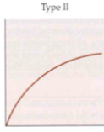
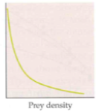
Apparent Competition
Number of prey eaten per predator per unit time
Prey per capita death rate
Prey density
DeCesare, N. J., Hebblewhite, M., Robinson, H. S., & Musiani, M. (2010). Endangered, apparently: the role of apparent competition in endangered species conservation. Animal conservation, 13(4), 353-362.
http://upload.wikimedia.org/wikipedia/commons/f/f4/Urocyon_littoralis_full_figure.jpg
http://www.dpi.nsw.gov.au/__data/assets/image/0005/444173/Vanessa-Macdonald_feral-pig-web.jpg
Notes:
The fear here is that golden eagles, being generalist predators, don’t need the Channel Island foxes in order to persist because they are subsidized by a more abundant primary prey, the feral pigs…

Slide 11
Apparent Competition
Type II – Depensatory predation
Number of prey eaten per predator per unit time
Prey per capita death rate
Prey density
DeCesare, N. J., Hebblewhite, M., Robinson, H. S., & Musiani, M. (2010). Endangered, apparently: the role of apparent competition in endangered species conservation. Animal conservation, 13(4), 353-362.
http://upload.wikimedia.org/wikipedia/commons/f/f4/Urocyon_littoralis_full_figure.jpg
http://www.dpi.nsw.gov.au/__data/assets/image/0005/444173/Vanessa-Macdonald_feral-pig-web.jpg
Notes:
…so the eagles can hunt the foxes to extinction without going extinct themselves.

Slide 12
Apparent Competition
Type II – Depensatory predation
Number of prey eaten per predator per unit time
A numeric response to secondary prey with a positive y-intercept, a key symptom of apparent competition (Messier 1995)
Prey per capita death rate
Prey density
DeCesare, N. J., Hebblewhite, M., Robinson, H. S., & Musiani, M. (2010). Endangered, apparently: the role of apparent competition in endangered species conservation. Animal conservation, 13(4), 353-362.
http://upload.wikimedia.org/wikipedia/commons/f/f4/Urocyon_littoralis_full_figure.jpg
http://www.dpi.nsw.gov.au/__data/assets/image/0005/444173/Vanessa-Macdonald_feral-pig-web.jpg
Notes:
In the paper, they point out the positive y-intercept of the Type II functional response as a “key symptom of apparent competition”, and this is a very misleading statement.

Slide 13
Is apparent competition always a conservation concern?
Type II – Depensatory predation
Number of prey eaten per predator per unit time
A numeric response to secondary prey with a positive y-intercept, a key symptom of apparent competition (Messier 1995)
Prey per capita death rate
Prey density
DeCesare, N. J., Hebblewhite, M., Robinson, H. S., & Musiani, M. (2010). Endangered, apparently: the role of apparent competition in endangered species conservation. Animal conservation, 13(4), 353-362.
http://upload.wikimedia.org/wikipedia/commons/f/f4/Urocyon_littoralis_full_figure.jpg
http://www.dpi.nsw.gov.au/__data/assets/image/0005/444173/Vanessa-Macdonald_feral-pig-web.jpg
Notes:
It’s misleading because it begs the question—why don’t all situations of apparent competition (which are really ubiquitous in almost every food web out there)— lead to depensatory predation? How can two prey species with a shared predator coexist without one going extinct?

Slide 14
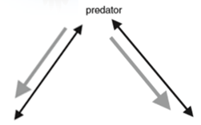
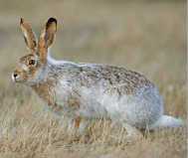
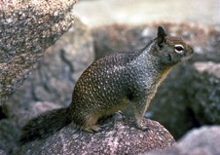
Is apparent competition always a conservation concern?
http://cdn1.arkive.org/media/22/22EBE45F-60E9-455B-910E-DBDC2D6FE10B/Presentation.Large/Side-profile-of-white-tailed-jackrabbit-.jpg
http://wdfw.wa.gov/conservation/gray_squirrel/graphics/cagrnd_squirrel.jpg
Notes:
In other words, would we expect, in a system of two other native, apparent competitors with golden eagles as a shared predator, for one prey species to face the same conservation concern as the Channel Island fox?

Slide 15
Recall that there are multiple forms of apparent competition:
http://cdn1.arkive.org/media/22/22EBE45F-60E9-455B-910E-DBDC2D6FE10B/Presentation.Large/Side-profile-of-white-tailed-jackrabbit-.jpg
Notes:
Well the paper that we read focused only on examples of asymmetrical apparent competition. But recall that there’s more than one type of apparent competition. Apparent competition is present in almost every food web you could think of. In fact, apparent competition, which arises from multi-prey systems, is usually a mechanism of maintaining stability in a food web.

Slide 16
Recall that there are multiple forms of apparent competition:
Notes:
So, yes, a greater abundance of white-tailed jackrabbits might cause a decrease in California ground squirrels via increased predation by their shared predator.

Slide 17
Frequency-dependent selection
Prey switching
Plasticity in predator preference
http://jwilson.coe.uga.edu/EMAT6680Fa2012/Faircloth/Activity1alf/AFsin3.png
Notes:
In this highly idealized model, the eagle shifts its preference to the more abundant prey species, jackrabbit, which allows the island fox population to recover. If island fox populations become more abundant than the heavily preyed jackrabbit, then prey switching can occur again.

Slide 18
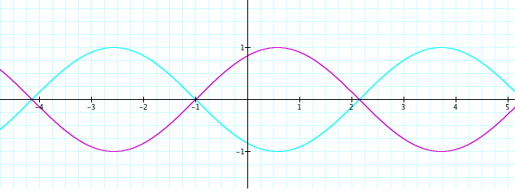
Frequency-dependent selection
Prey switching
Plasticity in predator preference
http://jwilson.coe.uga.edu/EMAT6680Fa2012/Faircloth/Activity1alf/AFsin3.png
Notes:
In this highly idealized model, the eagle shifts its preference to the more abundant prey species, jackrabbit, which allows the California ground squirrel population to recover. If island fox populations become more abundant than the heavily preyed jackrabbit, then prey switching can occur again.

Slide 19
Frequency-dependent selection
Prey switching
Plasticity in predator preference
Notes:
In this highly idealized model, the eagle shifts its preference to the more abundant prey species, jackrabbit, which allows the island fox population to recover. If island fox populations become more abundant than the heavily preyed jackrabbit, then prey switching can occur again.

Slide 20
Frequency-dependent selection
Prey switching
Plasticity in predator preference
Notes:
You can see the parallels with Tilman’s negative covariance effects. Or that the golden eagle’s diverse portfolio of prey populations factors into the stability of the food web.

Slide 21
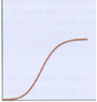
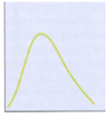
Frequency-dependent selection
Prey switching
Plasticity in predator preference
Both prey species experience regulatory predation (Type III curve)
Type III – Regulatory predation
Number of prey eaten per predator per unit time
Prey per capita death rate
Prey density
Notes:
And it is through this mechanism of prey switching, that regulator predation (a Type III functional response curve) can allow both prey species and the predator species to persist with .
So what factors decide whether two apparently competing species can coexist (like the island fox and the jackrabbit) or whether one will become endangered or extinct?

Slide 22
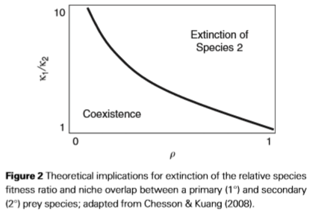
What Factors Determine Whether Two Apparent Competitors can Coexist?
Niche overlap (x-axis)
Applies to both exploitative and apparent competition
Notes:
Niche overlap is represented by the Greek letter rho

Slide 23
What Factors Determine Whether Two Apparent Competitors can Coexist?
Niche overlap (x-axis)
Applies to both exploitative and apparent competition
Overlap in resource consumption niches
(e.g. what/when/where they eat)
Notes:
In exploitative competition, the focus is on rho-R – the overlap in resource consumption niches. What they eat, when they eat, where they eat it

Slide 24
What Factors Determine Whether Two Apparent Competitors can Coexist?
Niche overlap (x-axis)
Applies to both exploitative and apparent competition
Overlap in resource consumption niches
(e.g. what/when/where they eat)
Overlap in source of predation niches
What eats them
Where it is eaten
Notes:
In apparent competition, rho – P represents the overlap in source of predation—what eats them and which one is preferred?

Slide 25
What Factors Determine Whether Two Apparent Competitors can Coexist?
Niche overlap (x-axis)
Relative competitive fitness ratio (y-axis)
Applies to both exploitative and apparent competition
Species fitness ratio
Notes:
On the y-axis we have the species fitness ratio k1/k2

Slide 26
What Factors Determine Whether Two Apparent Competitors can Coexist?
Niche overlap (x-axis)
Relative competitive fitness ratio (y-axis)
Applies to both exploitative and apparent competition
Species fitness ratio
1. Resource driven growth rates
Maintenance requirements of prey species per unit resource
Maximum rate of resource harvest
Notes:
K1/k2 considers the relative resource driven growth rates of each apparent competitor including the maintenance requirements per unit resource and the maximum rate of resource harvest

Slide 27
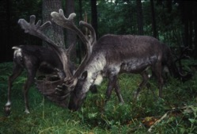
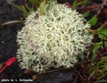
What Factors Determine Whether Two Apparent Competitors can Coexist?
Niche overlap (x-axis)
Relative competitive fitness ratio (y-axis)
Applies to both exploitative and apparent competition
Species fitness ratio
1. Resource driven growth rates
Maintenance requirements of prey species per unit resource
Maximum rate of resource harvest
http://www.wildernessclassroom.com/wp/wp-content/uploads/2012/05/caribou_Bauer_7094.jpg
http://www.aitc.sk.ca/saskschools/animals/images/rdeerlichen.jpg
Notes:
For example, the key component of a caribou’s diet is lichen growing on old-growth trees and on _____. The rate of harvest and areas where they can find this food source is limited…

Slide 28
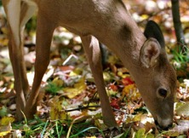
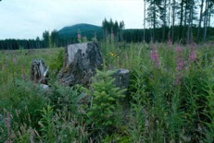
What Factors Determine Whether Two Apparent Competitors can Coexist?
Niche overlap (x-axis)
Relative competitive fitness ratio (y-axis)
Applies to both exploitative and apparent competition
Species fitness ratio
1. Resource driven growth rates
Maintenance requirements of prey species per unit resource
Maximum rate of resource harvest
http://www.ricka.org/Conservation/eating_leaves.jpg
http://www.tarleton.edu/Departments/range/Ram%20Pictures/0486%20regeneration%20of%2036.jpg
Notes:
..In comparison, their apparent competitor white-tailed deer forage on a wide range of early seral stage grasses and shrubs that occur in great abundance, especially in landscapes with increasing disturbance through forestry, so their population can really explode with an abundance of food.

Slide 29
What Factors Determine Whether Two Apparent Competitors can Coexist?
Niche overlap (x-axis)
Relative competitive fitness ratio (y-axis)
Applies to both exploitative and apparent competition
Species fitness ratio
1. Resource driven growth rates
Maintenance requirements of prey species per unit resource
Maximum rate of resource harvest
2. Sensitivity to predation
Prey behaviour
Prey population robustness
Notes:
Sensitivity to predation is also considered for the species fitness ratio.

Slide 30
Q: Considering
Niche overlap ( )
Relative competitive fitness ( )
how can apparent competition be stabilized?
Notes:
So considering the two factors influencing whether apparent competitors can coexist, how can asymmetric apparent competition (leaning toward extinction of species 2) be stabilized?

Slide 31
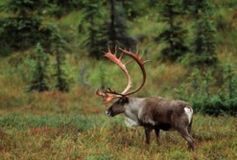
Q: Considering
Niche overlap ( )
Relative competitive fitness ( )
how can apparent competition be stabilized?
Spatial Refuges
Sinclair et al. (1998) found that endangered prey species could only be conserved if they had refuges from predation
Old-growth forests and muskeg
http://mvfn.ca/wordpress/wp-content/uploads/2013/09/Woodland-Caribou-Tessier-1024x690.jpg
Notes:
Sinclair et al. found that endangered prey species could only be conserved if they had refuges from predation. Woodland caribou, for example, have dense old-growth forests and muskeg that, in the past, had were not easily accessible to wolves. Unfortunately, the spatial refuges themselves are dwindling due to deforestation, peat harvesting, mining. And to add to that, wolves have greater access to spatial refuges with extensive cutlines for seismic oil and gas exploration in the boreal forest.

Slide 32
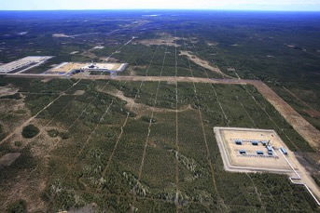
Q: Considering
Niche overlap ( )
Relative competitive fitness ( )
how can apparent competition be stabilized?
Spatial Refuges
Area of spatial refuges decreased by deforestation, peat harvesting, mining
Wolves have greater access with seismic lines
Old-growth forests and muskeg
http://mvfn.ca/wordpress/wp-content/uploads/2013/09/Woodland-Caribou-Tessier-1024x690.jpg
Notes:
Sinclair et al. found that endangered prey species could only be conserved if they had refuges from predation. Woodland caribou, for example, have dense old-growth forests and muskeg that, in the past, had were not easily accessible to wolves. Unfortunately, the spatial refuges themselves are dwindling due to deforestation, peat harvesting, mining. And to add to that, wolves have greater access to spatial refuges with extensive cutlines for seismic oil and gas exploration in the boreal forest.

Slide 33
Q: Considering
Niche overlap ( )
Relative competitive fitness ( )
how can apparent competition be stabilized?
Spatial Refuges
Removal of spatial refuges
By removing spatial refuges, the relative competitive fitness may increase as the secondary prey becomes more vulnerable to predation
Old-growth forests and muskeg
http://mvfn.ca/wordpress/wp-content/uploads/2013/09/Woodland-Caribou-Tessier-1024x690.jpg
Notes:
Sinclair et al. found that endangered prey species could only be conserved if they had refuges from predation. Woodland caribou, for example, have dense old-growth forests and muskeg that, in the past, had were not easily accessible to wolves. Unfortunately, the spatial refuges themselves are dwindling due to deforestation, peat harvesting, mining. And to add to that, wolves have greater access to spatial refuges with extensive cutlines for seismic oil and gas exploration in the boreal forest.

Slide 34
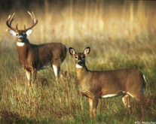
Q: Considering
Niche overlap ( )
Relative competitive fitness ( )
how can apparent competition be stabilized?
Spatial Refuges
Spatial Heterogeneity
Spatial sympatry can decouple shared predation dynamics by isolating predator-prey relationships distinctly among heterogeneous habitats
Old-growth forests and muskeg
Early seral stage habitat
https://web.duke.edu/nicholas/bio217/ekc7/white_tailed_deer1.jpg
http://mvfn.ca/wordpress/wp-content/uploads/2013/09/Woodland-Caribou-Tessier-1024x690.jpg
Notes:
Spatial heterogenetiy is another way that asymmetric apparent competition can be stabilized. Caribou and deer have very different habitats where caribou spend more time in lowland old-growth and muskeg while deer are in upland areas and disturbed habitats like cutblocks. Well, an argument from the assigned reading is that spatial sympatry can decouple shared predation dynamics by isolating the predator-prey relationships distinctly among heterogeneous habitats. In other words, wolves have a numeric response to deer in the uplands and a numeric response to caribou in the lowlands. However…

Slide 35
Q: Considering
Niche overlap ( )
Relative competitive fitness ( )
how can apparent competition be stabilized?
Spatial Refuges
Spatial Heterogeneity
The degree of this decoupling depends on the scale of predator movement (Holt 1984)
Old-growth forests and muskeg
Early seral stage habitat
http://dreamatico.com/wolf.html
Notes:
This depends on the scale of predator movement and obviously, a wolf can cover a large area with pack territories encompassing both deer and caribou habitat.

Slide 36
Q: Considering
Niche overlap ( )
Relative competitive fitness ( )
how can apparent competition be stabilized?
Spatial Refuges
Spatial Heterogeneity
Industrial development can reduce spatial heterogeneity
(e.g. deforestation) and/or enhance predator movement
(e.g. seismic exploration lines)
https://web.duke.edu/nicholas/bio217/ekc7/white_tailed_deer1.jpg
http://www.energytrendsinsider.com/wp-content/uploads/2013/11/Seismic-Surveys-from-WWF.jpg?00cfb7
http://mvfn.ca/wordpress/wp-content/uploads/2013/09/Woodland-Caribou-Tessier-1024x690.jpg
Notes:
As I mentioned before, the mobility of wolves is even further enhanced when industrial linear features give wolves access to boreal caribou spatial refuges. Clear-cutting not only reduces spatial heterogeneity and availability of caribou refuges, but also decreases the distance between caribou habitat and deer habitat.

Slide 37
Q: Considering
Niche overlap ( )
Relative competitive fitness ( )
how can apparent competition be stabilized?
Spatial Refuges
Spatial Heterogeneity
Decreasing spatial sympatry
Reduced segregation of deer and caribou habitat increases predation niche overlap (e.g. where they are hunted)
https://web.duke.edu/nicholas/bio217/ekc7/white_tailed_deer1.jpg
http://www.energytrendsinsider.com/wp-content/uploads/2013/11/Seismic-Surveys-from-WWF.jpg?00cfb7
http://mvfn.ca/wordpress/wp-content/uploads/2013/09/Woodland-Caribou-Tessier-1024x690.jpg
Notes:
As I mentioned before, the mobility of wolves is even further enhanced when industrial linear features give wolves access to boreal caribou spatial refuges. Clear-cutting not only reduces spatial heterogeneity and availability of caribou refuges, but also decreases the distance between caribou habitat and deer habitat.

Slide 38
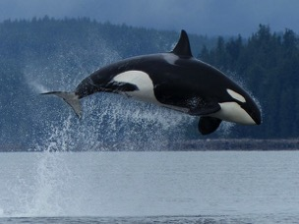
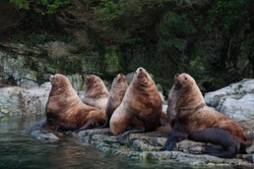
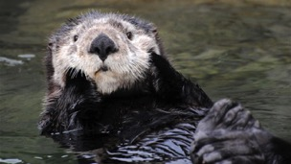
Q: Considering
Niche overlap ( )
Relative competitive fitness ( )
how can apparent competition be stabilized?
Spatial Refuges
Spatial Heterogeneity
Fisher et al. (2014) found that recolonizing sea otters spatially segregate from pinnipeds
http://cdn.grindtv.com/wp-content/uploads/2013/06/orca4.jpg
http://bcwhalewatchingtours.com/~bcwhalewatchingt/tipe/pictures/wildlife/Stellar_Sealion_009.jpg
http://www.vanaqua.org/files/3713/1913/4319/tanu-cute.jpg
Notes:
Sinclair et al. found that endangered prey species could only be conserved if they had refuges from predation. Woodland caribou, for example, have dense old-growth forests and muskeg that, in the past, had low accessibility to wolves. Unfortunately, the spatial refuges themselves are dwindling due to deforestation, peat harvesting, mining. Additionally, wolves have greater access to spatial refuges with extensive cutlines for seismic oil and gas exploration in the boreal forest.

Slide 39
Q: Considering
Niche overlap ( )
Relative competitive fitness ( )
how can apparent competition be stabilized?
Spatial Refuges
Spatial Heterogeneity
Fisher et al. (2014) found that recolonizing sea otters spatially segregate from pinnipeds
http://cdn.grindtv.com/wp-content/uploads/2013/06/orca4.jpg
http://bcwhalewatchingtours.com/~bcwhalewatchingt/tipe/pictures/wildlife/Stellar_Sealion_009.jpg
http://www.vanaqua.org/files/3713/1913/4319/tanu-cute.jpg
Notes:
Sinclair et al. found that endangered prey species could only be conserved if they had refuges from predation. Woodland caribou, for example, have dense old-growth forests and muskeg that, in the past, had low accessibility to wolves. Unfortunately, the spatial refuges themselves are dwindling due to deforestation, peat harvesting, mining. Additionally, wolves have greater access to spatial refuges with extensive cutlines for seismic oil and gas exploration in the boreal forest.

Slide 40
Q: Considering
Niche overlap ( )
Relative competitive fitness ( )
how can apparent competition be stabilized?
Spatial Refuges
Spatial Heterogeneity
Choosing areas spatially segregated from apparent competitor
By moving away from apparent competitors, their predation niche overlap (e.g. where they are hunted) is reduced
http://cdn.grindtv.com/wp-content/uploads/2013/06/orca4.jpg
http://bcwhalewatchingtours.com/~bcwhalewatchingt/tipe/pictures/wildlife/Stellar_Sealion_009.jpg
http://www.vanaqua.org/files/3713/1913/4319/tanu-cute.jpg
Notes:
Sinclair et al. found that endangered prey species could only be conserved if they had refuges from predation. Woodland caribou, for example, have dense old-growth forests and muskeg that, in the past, had low accessibility to wolves. Unfortunately, the spatial refuges themselves are dwindling due to deforestation, peat harvesting, mining. Additionally, wolves have greater access to spatial refuges with extensive cutlines for seismic oil and gas exploration in the boreal forest.

Slide 41
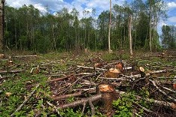
Common Elements of Asymmetric Apparent Competition
Human-induced changes to:
Resources (alteration of habitats)
http://edienet.s3.amazonaws.com/library/features/images/6431.jpg
Notes:
In summary, three common elements to all the examples of asymmetric apparent competition in the assigned reading include Human-induced changes to resources (e.g. alteration of habitat like clear-cutting, which alters the food availability and spatial heterogeneity of the landscape)

Slide 42
Common Elements of Asymmetric Apparent Competition
Human-induced changes to:
Resources (alteration of habitats)
Predator and Prey Communities (introduced species)
Notes:
Changes to predator and prey communities, such as the feral pig.

Slide 43
Common Elements of Asymmetric Apparent Competition
Human-induced changes to:
Resources (alteration of habitats)
Predator and Prey Communities (introduced species)
Predator population supported by an abundant primary prey species
Native species with increasing populations due to human-induced change
Introduced species
Notes:
A second common element is the subsidization of the predator population with an abundant primary prey species. Perhaps this abundant prey population has been introduced (like the feral pig) or maybe the native species populations have been augmented by human-induced change. An example of this is the increase in moose and deer populations with greater availability of early seral stage food after disturbance.

Slide 44
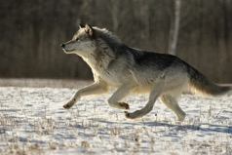
Common Elements of Asymmetric Apparent Competition
Human-induced changes to:
Resources (alteration of habitats)
Predator and Prey Communities (introduced species)
Predator population supported by an abundant primary prey species
Native species with increasing populations due to human-induced change
Introduced species
Generalist predators (e.g. canids, felids, corvids) which forage beyond the spatial scale of habitat partitioning between apparent competitors
http://www.vantagepointimages.com/uploads/processed/1015/1004040809061wolf-running-059-w.jpg
Notes:
And thirdly, a generalist predator with multiple prey species which can forage beyond the spatial scale of habitat partioning between apparent competitors.

Slide 45
Discussion

Slide 46
Literature Cited
Brown, J. S., & Morgan, R. A. (1995). Effects of foraging behavior and spatial scale on diet selectivity: a test with fox squirrels. Oikos, 122-136.
Chaneton, E. J., & Bonsall, M. B. (2000). Enemy‐mediated apparent competition: empirical patterns and the evidence. Oikos, 88(2), 380-394.
DeCesare, N. J., Hebblewhite, M., Robinson, H. S., & Musiani, M. (2010). Endangered, apparently: the role of apparent competition in endangered species conservation. Animal conservation, 13(4), 353-362.
Fisher, J. T., Pasztor, C., Wilson, A., Volpe, J. P., & Anholt, B. R. (2014). Recolonizing sea otters spatially segregate from pinnipeds on the Canadian Pacific coastline: The implications of segregation for species conservation. Biological Conservation, 177, 148-155.
Hails, R. S., & Crawley, M. J. (1991). The population dynamics of an alien insect: Andricus quercuscalicis (Hymenoptera: Cynipidae). The Journal of Animal Ecology, 545-561.
Holt, R. D. (1977). Predation, apparent competition, and the structure of prey communities. Theoretical population biology, 12(2), 197-229.
Holt, R. D. (1984). Spatial heterogeneity, indirect interactions, and the coexistence of prey species. American Naturalist, 377-406.

